Slide 1
Section 10.3
The Ellipse

Slide 2
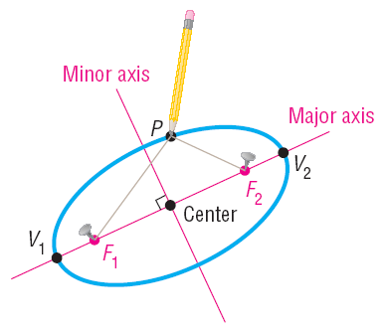

Slide 4

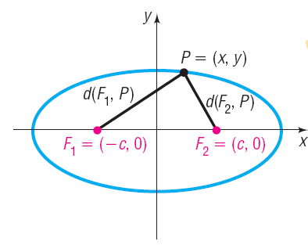

Slide 5
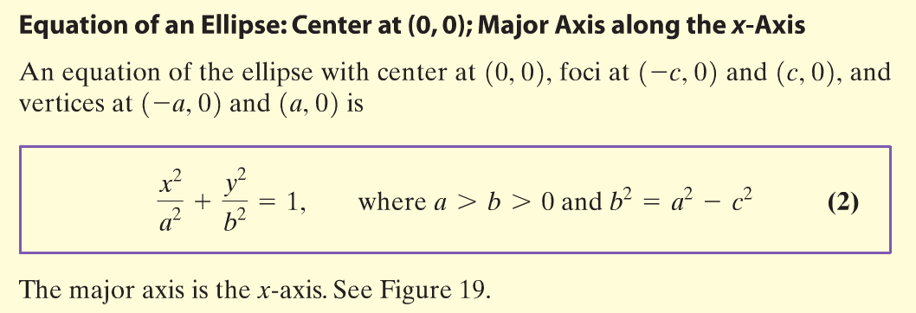
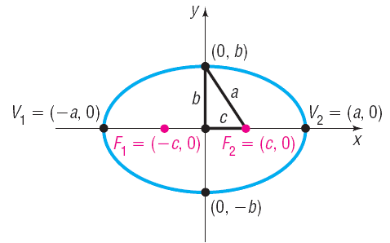

Slide 6


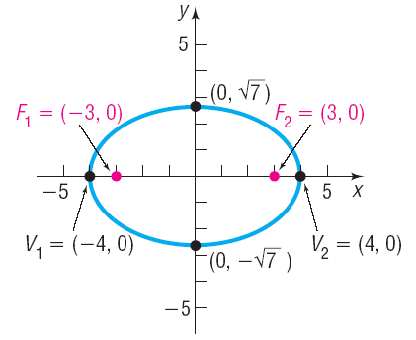



Find an equation of the ellipse with center at the origin, one focus at (3, 0) and a vertex at (– 4, 0). Graph the equation.
From the center to one vertex is a = 4. From the center to one focus is c = 3.

Slide 7
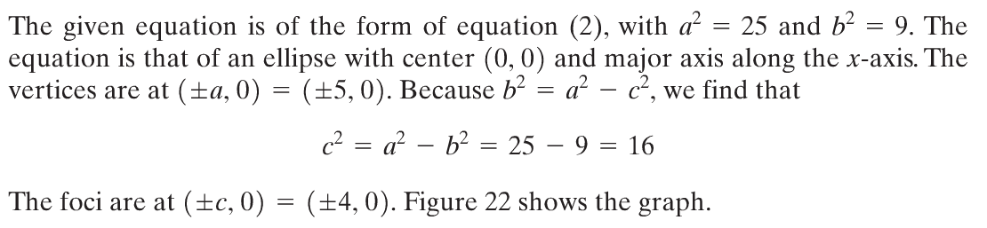
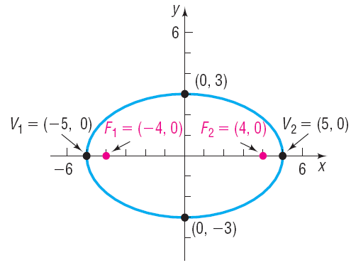

Figure 22

Slide 8
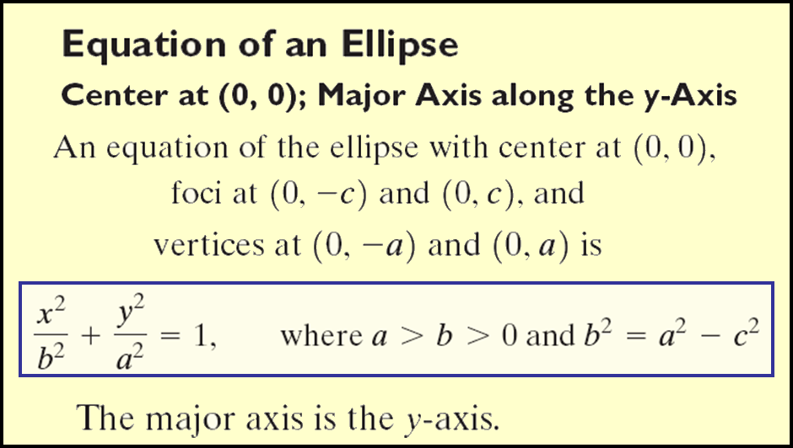
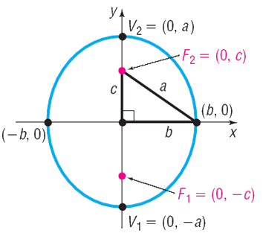

Slide 9

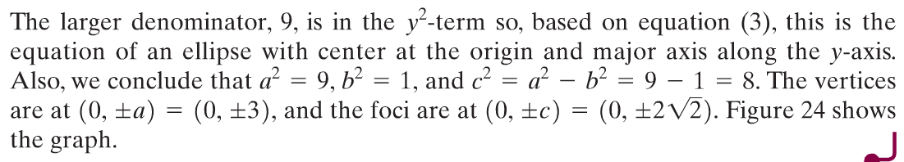
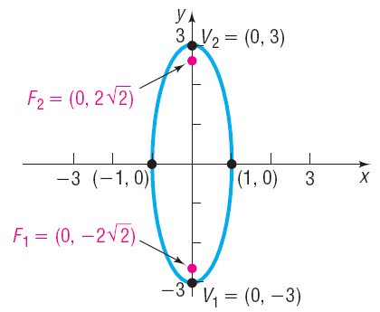
Figure 24

Slide 10

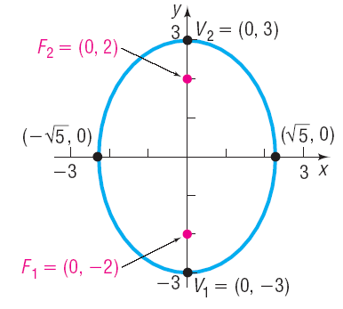



Find an equation of the ellipse having one focus at (0, 2) and vertices at (0, –3) and (0, 3). Graph the equation by hand.
The distance from the center to a focus is c = 2
The distance from the center to a vertex is a = 3

Slide 12
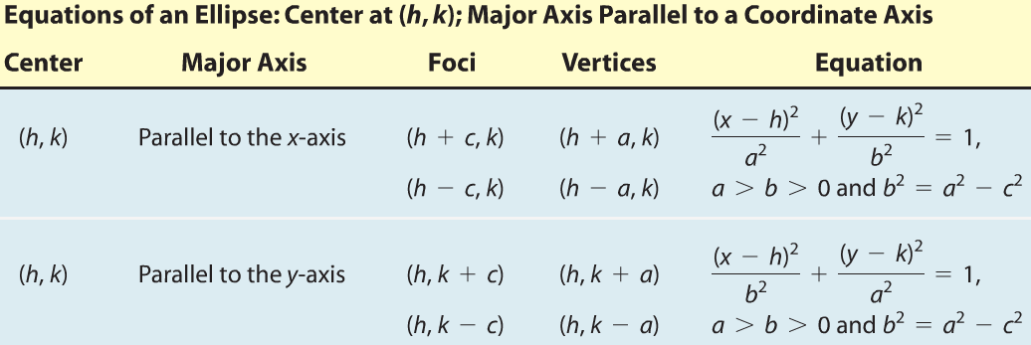
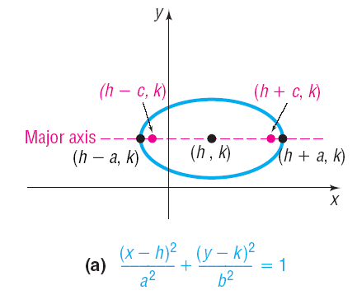
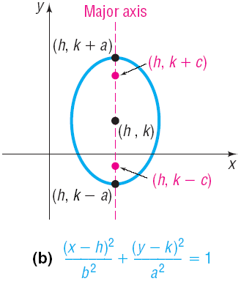

Slide 13



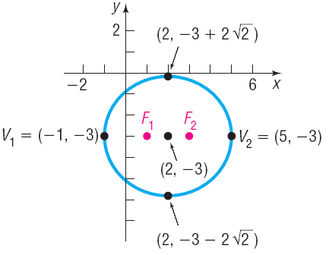

Find an equation for the ellipse with center at (2, –3), one focus at (3, –3), and one vertex at (5, –3). Graph the equation by hand.
Center and vertices lie on line y = – 3 so major axis is parallel to x-axis.
The distance from the center to a focus is c = 1;The distance from the center to a vertex is a = 3

Slide 14




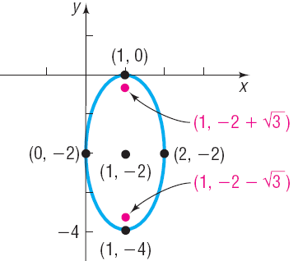


Slide 16
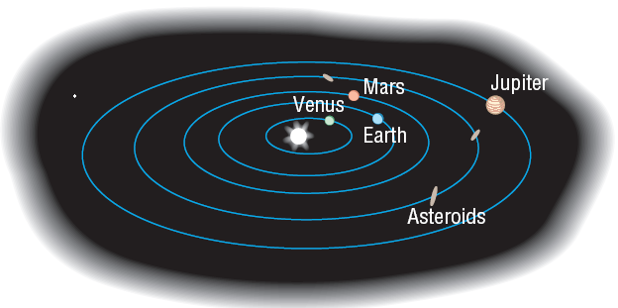

Slide 17





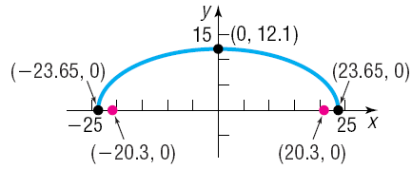

The whispering gallery in the Museum of Science and Industry in Chicago is 47.3 feet long. The distance from the center of the room to the foci is 20.3 feet. Find an equation that describes the shape of the room. How high is the room at its center?

